Slide 1



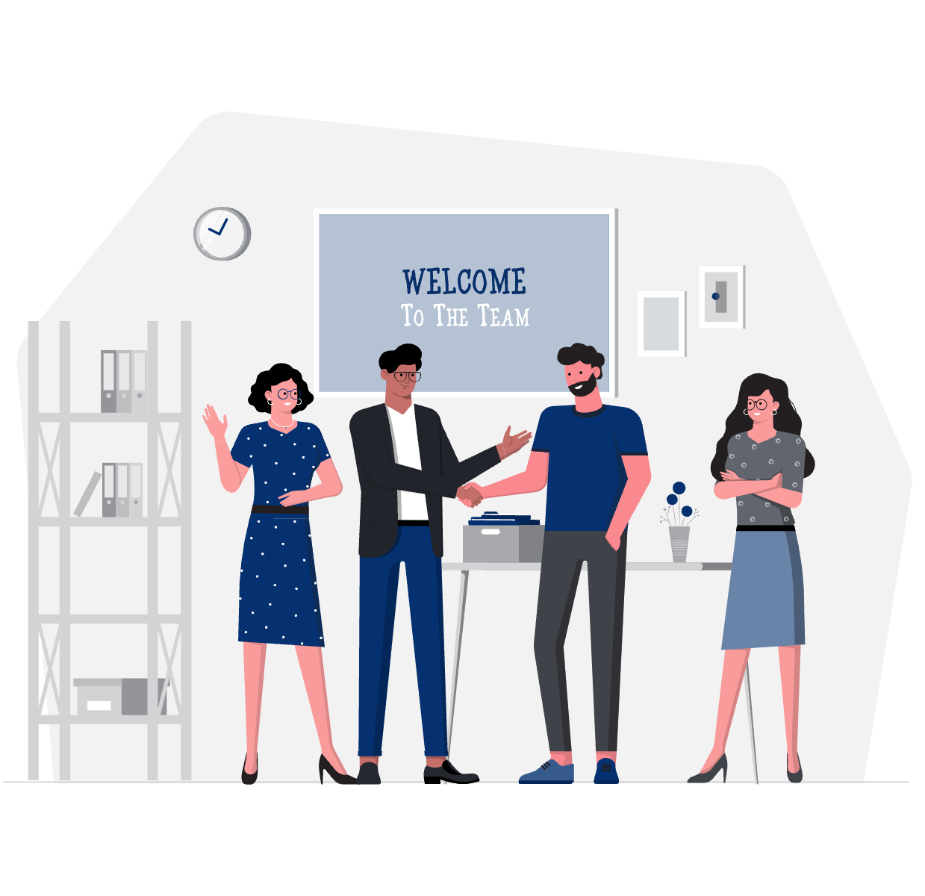
ADVANCED NATIVE MOBILE PROGRAMMING
NAVIGATION
WEEK 01 Informatics Engineering
Universitas Surabaya
Informatics Engineering | Universitas Surabaya
Notes:
Cover Dark
Gambar vector bisa didownload di: https://scale.flexiple.com/illustrations/
Jika ingin foto free royalty bisa download di: https://pixabay.com/photos/

Slide 2
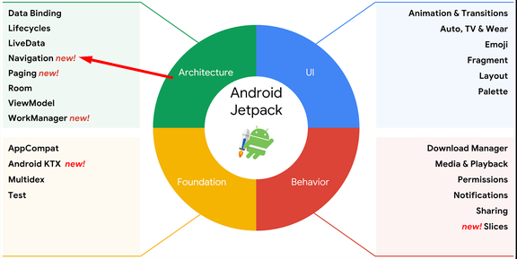
A BIT OF JETPACK
In 2018 Google launched the Jetpack.
Jetpack is a set of libraries, components, and tools which helps you to build a better application.
Informatics Engineering | Universitas Surabaya

Slide 3
NAVIGATION
Navigation refers to the interactions that allow users to navigate across, into, and back out from the different pieces of content within your app.
Previously in Native Mobile Programming course, you achieved this by implementing “intent” or “fragment manager”
This solution requires you to write different activity/fragment classes and manage the navigation/interaction manually
Informatics Engineering | Universitas Surabaya

Slide 4
NAVIGATION
Android Jetpack's Navigation component helps you implement navigation, from simple button clicks to more complex patterns, such as app bars and the navigation drawer.
It excels for apps with multiple Fragments.
The Navigation component consists of three key parts:
Navigation graph
NavHost
NavController
Informatics Engineering | Universitas Surabaya

Slide 5
NAVIGATION
A navigation graph is a resource file that contains all of your destinations and actions. The graph represents all of your app's navigation paths.
It represent the navigation flow from one fragment to another fragment. It could be simple or complex.
Informatics Engineering | Universitas Surabaya

Slide 6
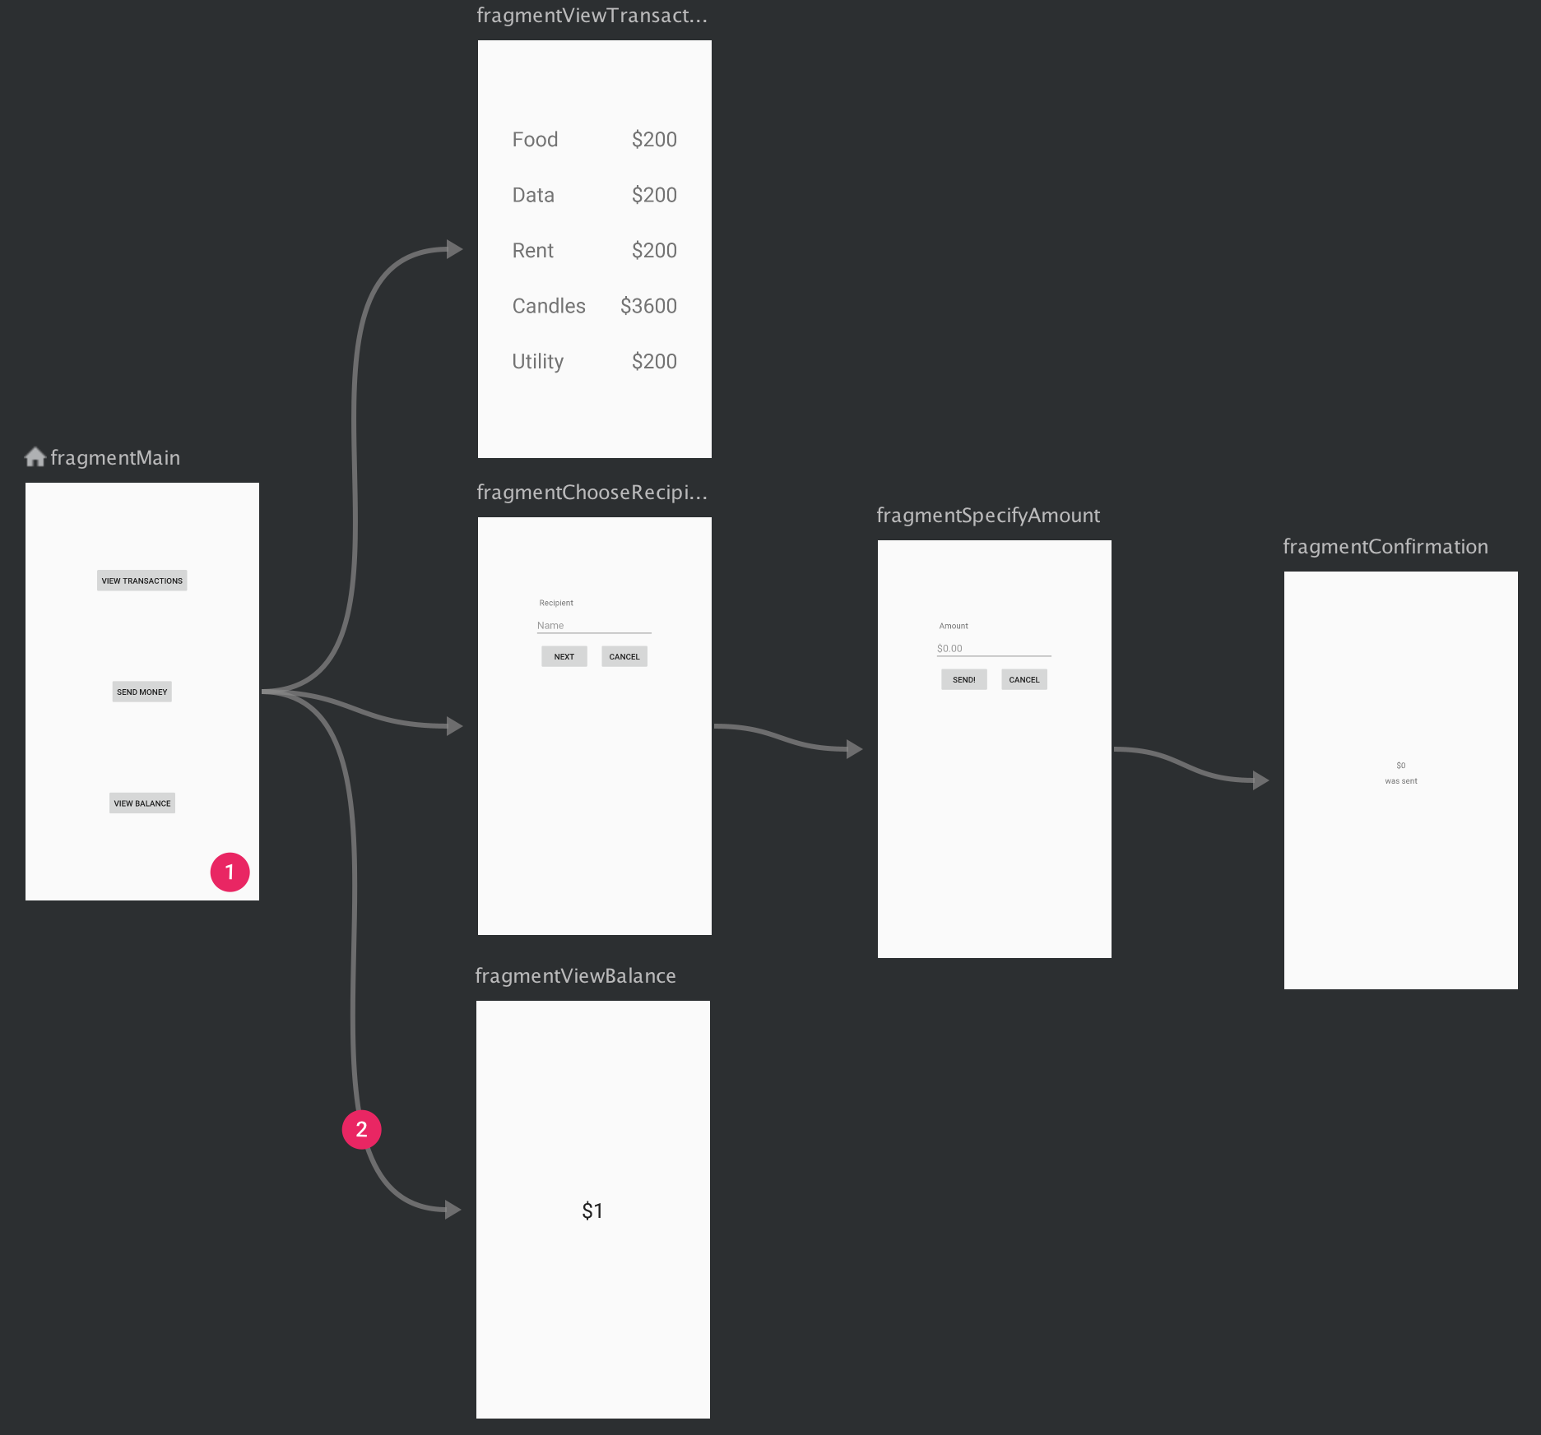
Example
navigation graph of a sample app containing six destinations connected by five actions.
Informatics Engineering | Universitas Surabaya

Slide 7
NAV HOST
The navigation host is an empty container where destinations are swapped in and out as a user navigates through your app.
The Navigation component is designed for apps that have one main activity with multiple fragment destinations.
In an app with multiple activity destinations, each activity has its own navigation graph.
Informatics Engineering | Universitas Surabaya

Slide 8
NAV CONTROLLER
NavController manages app navigation within a NavHost.
Navigation flows and destinations are determined by the navigation graph owned by the controller.
These graphs are typically inflated from an Android resource, but, like views, they can also be constructed or combined programmatically or for the case of dynamic navigation structure.
Informatics Engineering | Universitas Surabaya

Slide 9
WHY NAVIGATION?
Some additional benefits:
Fragment transactions are handled automatically
Back and Up buttons are handled correctly
Adding default animations and transitions are trivial
Implements Material Design navigation UI pattern (bottom nav, drawers) with ease
Navigation can be visualized in Android Studio, allowing easy understanding and editing
Passing information is easy and safe with help of SafeArgs plugin
Informatics Engineering | Universitas Surabaya

Slide 10
Tutorial
single activity, multiple fragments
Informatics Engineering | Universitas Surabaya

Slide 11
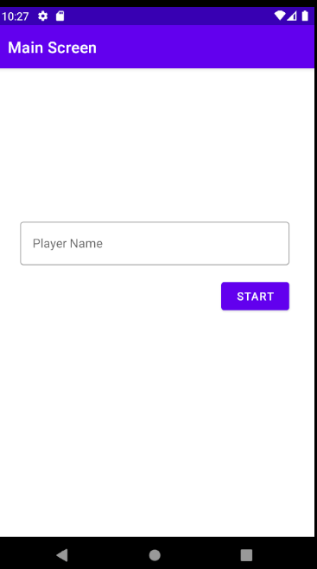
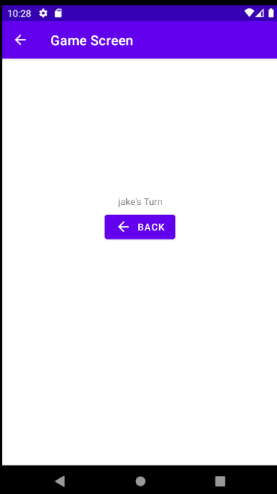
TUTORIAL INTRODUCTION
In the following tutorial, we’ll create single activity app with multi fragments.
Informatics Engineering | Universitas Surabaya

Slide 12
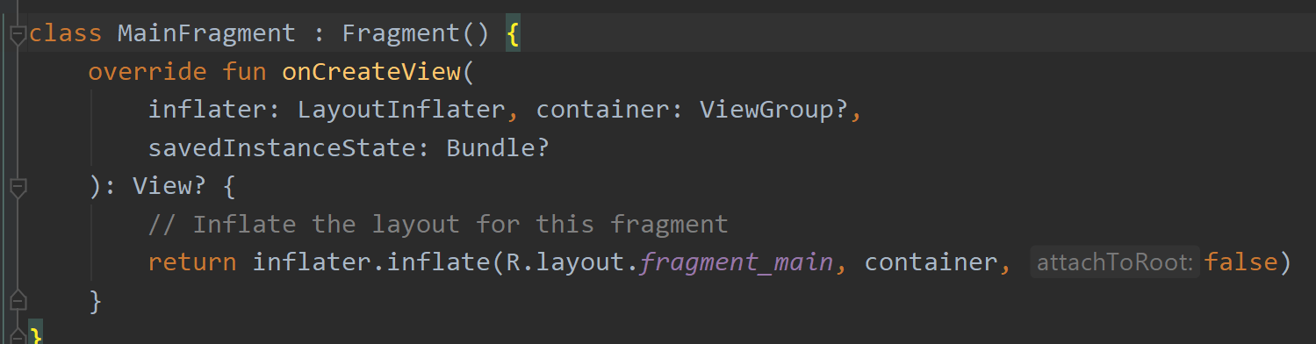
STEP 1: CREATE FRAGMENTS
Start with creating two fragments:
MainFragment (blank)
GameFragment (blank)
Remove all todo, all variables, remove onCreate, remove companion object. We don't need that in this case.
Informatics Engineering | Universitas Surabaya

Slide 13
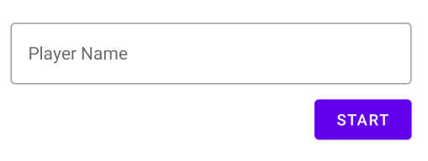
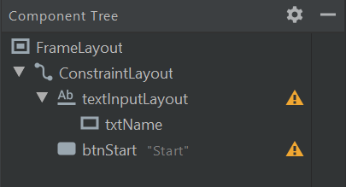
STEP 2: LAYOUT
Open fragment_main.xml, add a ConstraintLayout and arrange UI like image below:
editText inside textInputLayout
Id = txtName
Remove hint value
textInputLayout
Hint = “Player Name”
hintAnimationEnabled = true
hintEnabled = true

Slide 14

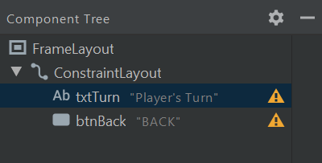
STEP 2: LAYOUT
Open fragment_game.xml, add a ConstraintLayout and arrange UI like image below
btnBack
Text = “back”
Icon = use vector assets icon back arrow

Slide 15
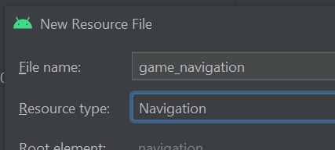
STEP 3: NAVIGATION GRAPH
Navigation graph is a resource file. XML based, that represent how fragment navigate to other destination.
To create navigation graph:
Right click on res > new > android resource file
Enter file name to game_navigation
Change resource type to Navigation
Press OK

Slide 16
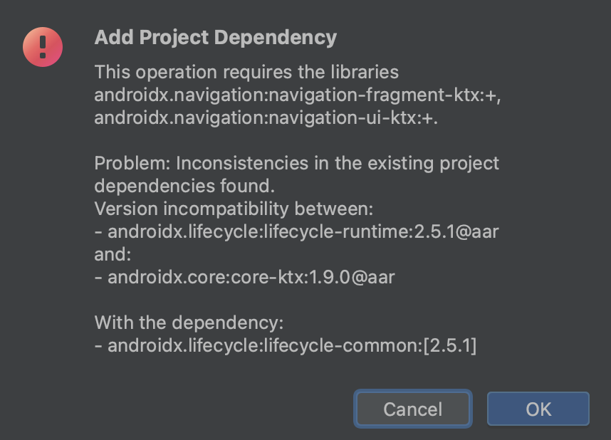
STEP 3: NAVIGATION GRAPH
Navigation graph needs additional dependency. This dialog will pop out and you can simply just press OK to continue. Wait until download and gradle process finished.

Slide 17
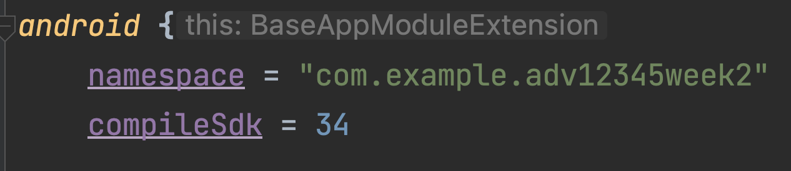
STEP 3: USE SDK 34
Latest version of navigation graph needs SDK version 34 to works. Therefore, open the gradle (module), and change the compileSdk config to 34. Don't forget to sync now, and expect to wait few minutes while gradle will download the necessary upgrade.

Slide 18
INSTALLING VIEW BINDING (1)
Android Jetpack Compose View Binding is a feature that allows you to more easily access views in your layouts from your code.
To enable view binding, first open your build.gradle (module)
Add following configuration and dont forget to press “Sync Now”
android { ...
buildFeatures {
viewBinding = true
}
}

Slide 19
INSTALLING VIEW BINDING (2)
View Binding will generate a class with name following pattern: [name of layout]Binding I.e: activity_main.xml -> ActivityMainBinding
Now open your MainxxActivity to configure the View Binding
class MainActivity : AppCompatActivity() {
private lateinit var binding: ActivityMainBinding override fun onCreate(savedInstanceState: Bundle?) {
super.onCreate(savedInstanceState)
binding = ActivityMainBinding.inflate(layoutInflater)
val view = binding.root
setContentView(view) // change the argument of setContentView
}
In case the ActivityMainBinding is not found, please rebuild your project

Slide 20
INSTALLING NAVIGATION SAFEARGS (1)
Now open build.gradle (Project) file. At the topmost line (after the comment, but before plugins block), copy this block (get it from here). Don't forget to “sync now”
buildscript {
repositories {
google()
}
dependencies {
val nav_version = "2.7.1" classpath("androidx.navigation:navigation-safe-args-gradle-plugin:$nav_version")
}
} plugins { . . . }

Slide 21
INSTALLING NAVIGATION SAFEARGS (2)
Go back to the other build.gradle file (the module one). Add this plugin:
plugins {
id("com.android.application")
id("org.jetbrains.kotlin.android")
id("androidx.navigation.safeargs.kotlin")
}
Sync your Gradle (make sure your machine is connected to the Internet)

Slide 22
SAFEARGS
SafeArgs is a gradle plugin that allows you to enter information into the navigation graph about the arguments that you want to pass.
It then generates code for you that handles the tedious bits of creating a Bundle for those arguments and pulling those arguments out of the Bundle on the other side.

Slide 23
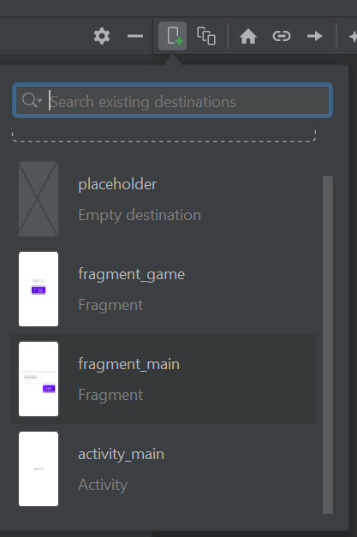
STEP 3: NAVIGATION GRAPH
Now we need to create navigation graph to define navigation in the app.
Start by clicking on New destination button
And then choose fragment_main
Repeat again and choose fragment_game

Slide 24
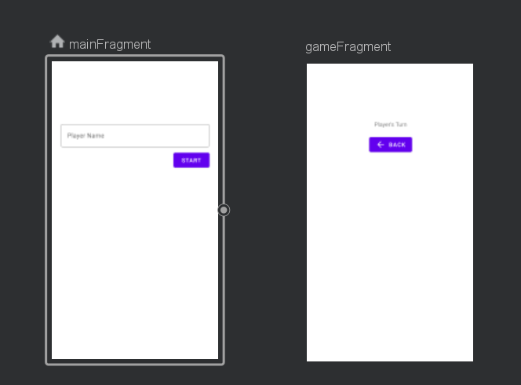
STEP 3: NAVIGATION GRAPH
Arrange the fragments like image below
Click on mainFragment change label property to “Main Screen”
Click on gameFragment and then change label property to “Game Screen”
In the navigation graph, these two objects are called “destinations”

Slide 25
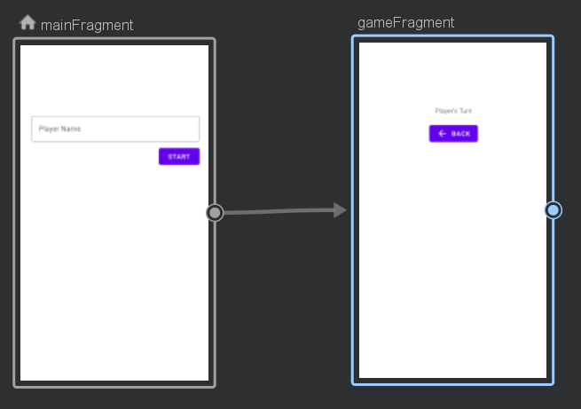
STEP 3: NAVIGATION GRAPH
Now we need to define the “actions” between destinations. Click and drag the small circle on the main fragment into the game fragment

Slide 26
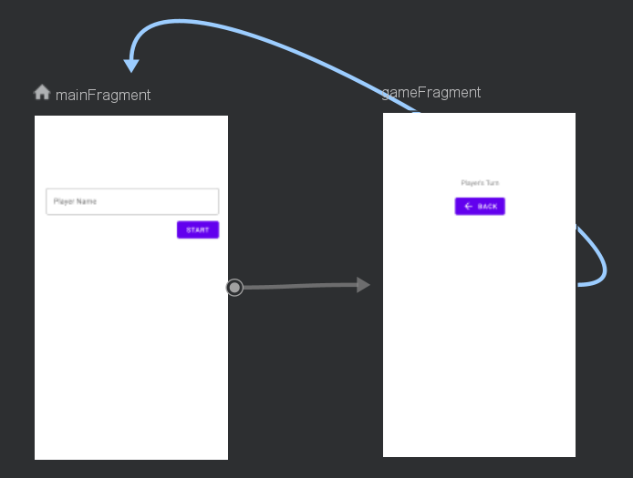
STEP 3: NAVIGATION GRAPH
Do the opposite. Drag small circle from game fragment to main fragment

Slide 27
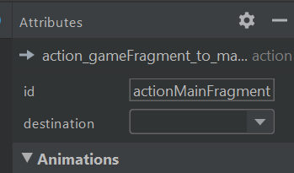
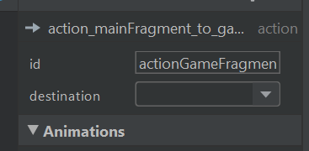
STEP 3: NAVIGATION GRAPH
Now click the arrow from main to game fragment. Rename the id to actionGameFragment
Continue to click on the arrow from game to main fragment, rename the id to actionMainFragment

Slide 28
STEP 3: NAVIGATION GRAPH
Those arrows are called “actions” to indicate navigation flow
IMPORTANT!
Every time you make a change on the navigation graph, you might need to rebuild the project (build > rebuild project)
It will trigger the safeargs library to generate necessary class needed in our kotlin codes
No need to rebuild on latest android studio

Slide 29
STEP 4: NAV HOST
Navigation graph must be implemented within a container, a nav host. To create nav host, open the activity_main.xml
Delete the default TextView
Drag and drop NavHostFragment component to screen
Choose game_navigation graph
Constrain it to all edges to make it full screen
Rename this navhost component id to hostFragment

Slide 30
STEP 5: CALL THE ACTIONS
The navigation graph only defines the navigation flows. The actions must be called manually in Kotlin codes. In this case, we want to trigger the action actionGameFragment when the Start button is pressed.
Informatics Engineering | Universitas Surabaya

Slide 31
STEP 5a: SETUP VIEW BINDING on MAIN FRAGMENT
Open the MainFragment.kt. Do following things to setup the ViewBinding
class MainFragment : Fragment() {
private lateinit var binding: FragmentMainBinding
override fun onCreateView( inflater: LayoutInflater, container: ViewGroup?, savedInstanceState: Bundle?): View? {
binding = FragmentMainBinding.inflate(
inflater,
container, false
)
return binding.root
}

Slide 32
STEP 5b: CALL THE ACTIONS
Open the MainFragment.kt. Override onViewCreated, and add btnStart click listener
override fun onViewCreated(view: View, savedInstanceState: Bundle?) {
super.onViewCreated(view, savedInstanceState) binding.btnStart.setOnClickListener { }
}
onViewCreated will be called after onCreateView. This means we can safely access and modify the view component in this method.

Slide 33
STEP 5c: CALL THE ACTIONS
Now write call actionGameFragment within the listener
override fun onViewCreated(view: View, savedInstanceState: Bundle?) {
super.onViewCreated(view, savedInstanceState)
binding.btnStart.setOnClickListener {
val action = MainFragmentDirections.actionGameFragment()
// Navigation.findNavController(it).navigate(action) it.findNavController().navigate(action)
}
}
MainFragmentDirections is class generated by safeargs. It holds all actions arrow that defined previously on navigation graph
To trigger navigation, simply call Navigation object and navigate method to the action

Slide 34
STEP 5d: SETUP VIEW BINDING IN GAME FRAGMENT
Remember to setup the view binding in Game Fragment
class GameFragment : Fragment() {
private lateinit var binding:FragmentGameBinding
override fun onCreateView(inflater: LayoutInflater, container: ViewGroup?,savedInstanceState: Bundle?): View? {
binding = FragmentGameBinding.inflate(inflater, container, false)
return binding.root
}

Slide 35
STEP 5e: CALL THE ACTIONS
Now do the opposite from Game fragment to Main fragment. Open the game fragment and write following codes.
override fun onViewCreated(view: View, savedInstanceState: Bundle?) {
super.onViewCreated(view, savedInstanceState)
binding.btnBack.setOnClickListener {
val action = GameFragmentDirections.actionMainFragment()
//Navigation.findNavController(it).navigate(action) it.findNavController().navigate(action)
}
}

Slide 36
STEP 6: ANDROID BACK BUTTON
The navigation controller manages the transition and navigation flow within your app with a single activity multi fragments concept.
Next step to set up the default “soft” android back button that is usually located on the top left corner of the app.
This back button is used to access the previous item on the back stack.

Slide 37
STEP 6: ANDROID BACK BUTTON
Open MainActivity.kt, create navController variable
class MainActivity : AppCompatActivity() {
private lateinit var binding: ActivityMainBinding
private lateinit var navController: NavController
The lateinit keyword stands for late initialization. Lateinit comes very handy when a non-null initializer cannot be supplied in the constructor, but the developer is certain that the variable will not be null when accessing it, thus avoiding null checks when referencing it later.
KotlinDevelopment.com

Slide 38
STEP 6: ANDROID BACK BUTTON
Open MainActivity.kt, create navController variable
override fun onCreate(savedInstanceState: Bundle?) {
super.onCreate(savedInstanceState)
binding = ActivityMainBinding.inflate(layoutInflater)
val view = binding.root
setContentView(view)
navController = (supportFragmentManager.findFragmentById(R.id.hostFragment) as NavHostFragment).navController
NavigationUI.setupActionBarWithNavController(this, navController)
}
These codes are used to initialize the Navigation Controller and associate it with NavHost object.
And then setup the action bar with soft button functionality

Slide 39
STEP 6: ANDROID BACK BUTTON
Next setup the action of this soft button
override fun onSupportNavigateUp(): Boolean {
return navController.navigateUp()
}
You may replace codes with navigation drawer mechanism. Therefore instead go back to previous stack, app will show the menu drawer

Slide 40
STEP 6: ANDROID BACK BUTTON
Make sure your project already have action bar. Open themes.xml (light and night)
<resources xmlns:tools="http://schemas.android.com/tools">
<!-- Base application theme. -->
<style name="Base.Theme.Week1ANMP" parent="Theme.Material3.DayNight">
Delete “NoActionBar” in this part

Slide 41
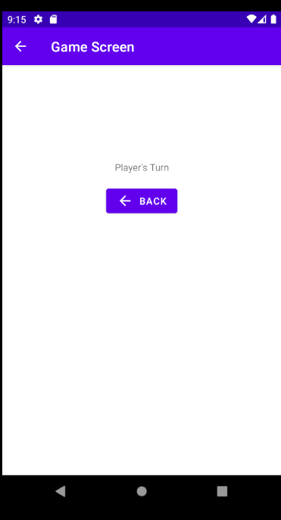
Subtopic
Notice that “soft” back button on the upper left of the screen. It will be displayed when needed.
If there is only one object on the back stack this button won't be shown.
Informatics Engineering | Universitas Surabaya

Slide 42
Arguments
Informatics Engineering | Universitas Surabaya

Slide 43
STEP 7: CREATE ARGUMENTS
Sometimes we need to send an object/variables to destinations. Previously in Native course we can do this by using the intent extra (activity) or bundle injection (fragment).
In this new android Navigation jetpack, you need to define the argument inside the navigation graph.
Open the game_navigation to continue
Notes:
Kalau pakai navigation harus pakai arguments

Slide 44
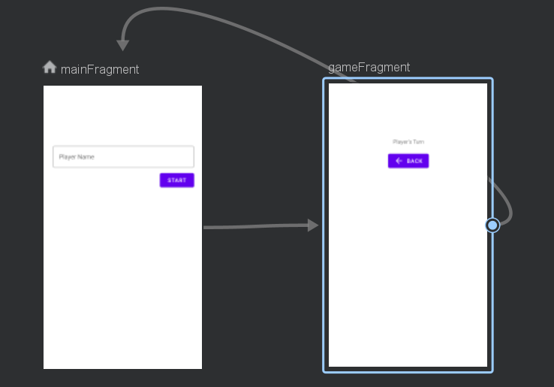
STEP 7: CREATE ARGUMENTS
In the Navigation graph, the gameFragment expected to receive Player Name data from mainFragment, and displayed on the text view “Player’s turn”

Slide 45
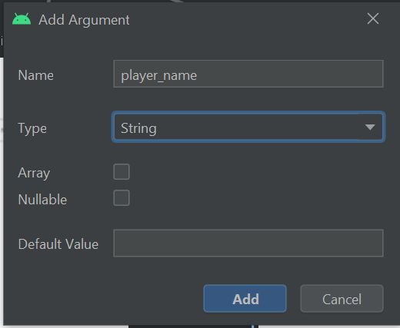
STEP 7a: CREATE ARGUMENTS
Click on the game fragment, and click plus icon on the arguments property.
A dialog pop out:
Set argument name as player_name
Set type to String
Press add
Don't forget to rebuild the project
Notes:
Jadi ini barang siapa yang masuk ke game fragment wajib memasukkan player name

Slide 46
STEP 7a: CREATE ARGUMENTS
Open the MainFragment.kt, and add following codes on the btnStart listener
binding.btnStart.setOnClickListener { val playerName = binding.txtName.text.toString()
val action = MainFragmentDirections.actionGameFragment(playerName)
Navigation.findNavController(it).navigate(action)
}
Retrieve the player name data from EditText, and then use the action
If you have multiple arguments, you may use comma in action fragment constructor. Ie. actionGameFragment(playerName, playerScore)

Slide 47
STEP 7b: CATCH ARGUMENTS
On the game frament side, we can receive the argument. Write following codes
override fun onViewCreated(view: View, savedInstanceState: Bundle?) {
super.onViewCreated(view, savedInstanceState)
val playerName = GameFragmentArgs.fromBundle(requireArguments()).playerName
binding.txtTurn.text = "$playerName's Turn"
GameFragmentArgs is another class created by the help of Safeargs

Slide 48
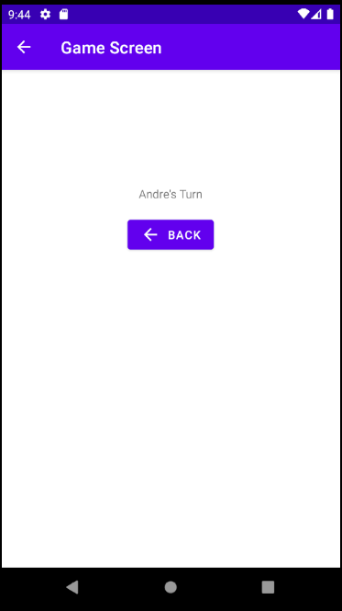
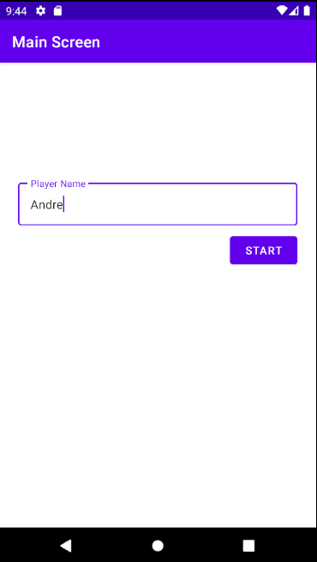
Results
Informatics Engineering | Universitas Surabaya

Slide 49
The Animation
Informatics Engineering | Universitas Surabaya

Slide 50
STEP 8: CHANGE TRANSITION ANIMATION
Android provide different set of transition animation effects. You can play with it in navigation graph.
Open the navigation graph
Click on the arrow action
Check on animation property
enterAnim = animation when entering this fragment
exitAnim = animation when exiting this fragment

Slide 51
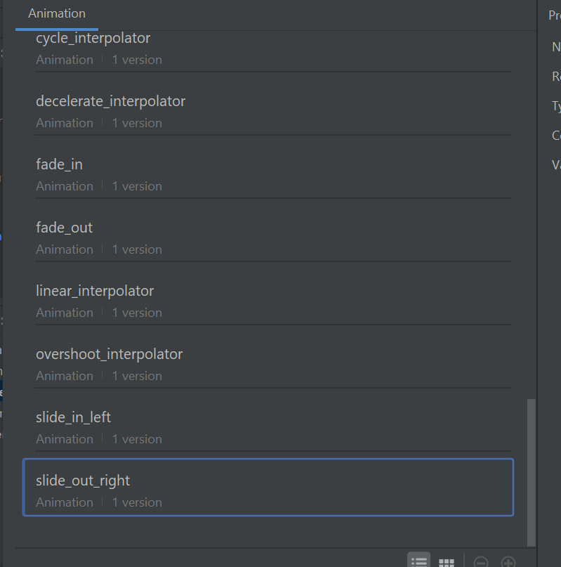
ANIMATION OPTION
Try different animation. Find the best that you like
Informatics Engineering | Universitas Surabaya

Slide 52
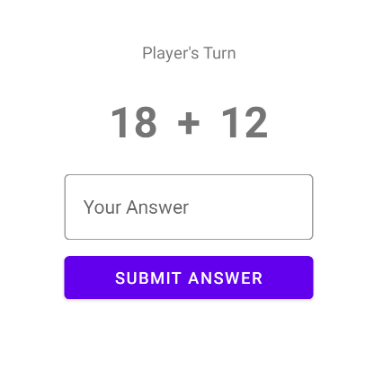
Class Exercise
The Layout
Adjust the game fragment layout by using image on the right as reference.
The Logic
Game will randomize two number. Player’s need to solve the addition equation.
The “Submit answer” button will check if the player’s answer is correct or not.
If the answer is correct then the player gets 1 point. If the answer is not correct, then the game ends immediately and navigates to the result screen.
Informatics Engineering | Universitas Surabaya

Slide 53
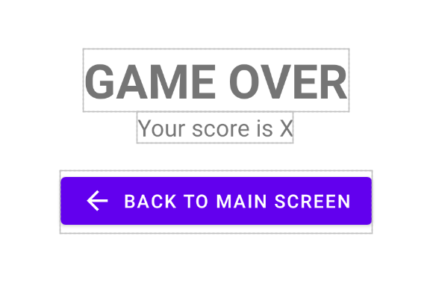
Class Exercise (Continue)
Create ResultFragment
The Layout
Use image on the left as references
The Logic
Display player score in “Your score” textview
Back to main screen button is used to navigate to main screen
Informatics Engineering | Universitas Surabaya

Slide 54
Thanks.
Informatics Engineering | Universitas Surabaya

